Slide 1
Introduction to Marketing Management
1

Slide 2
What is Marketing…??
Selling?
Advertising?
Promotions?
Making products available in stores?
Maintaining inventories?
All of the above, plus much more!
1

Slide 3
Marketing = ?
Marketing is the process of planning and executing the conception, pricing, promotion, and distribution of ideas, goods, services to create exchanges that satisfy individual and organizational goals
American Marketing Association
Marketing management is the art and science of choosing target markets and getting, keeping, and growing customers through creating, delivering, and communicating superior customer value.

Slide 4
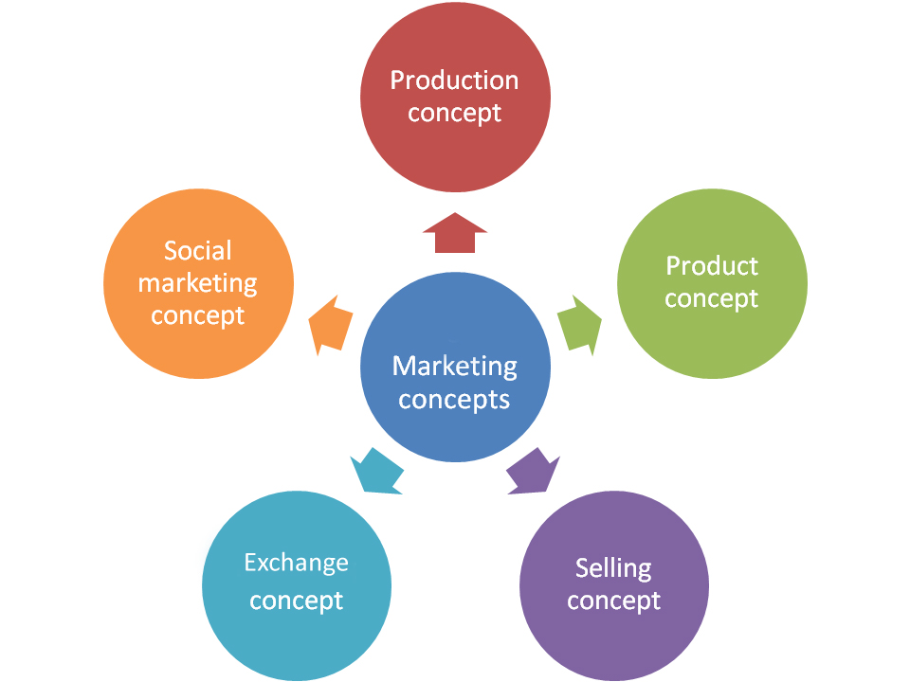
Marketing Concepts

Slide 5
Marketing Concepts
Definition
Marketing concepts can be defined as the marketing philosophies by which a firm’s goal can be best achieved through identification and satisfaction of the customers’ stated and unstated needs and wants.
Meaning
Companies adopt different philosophies in relation to marketing of their products. Some claim that they are customer oriented and others say that they offer value to their customers. Still others say that they treat their customers as kings. These philosophies in relation to marketing are known as marketing concepts.

Slide 6
Types of Marketing Concepts
Traditional Concepts
  Production Concept: The production concept holds that the consumer prefer the goods which are easily available at lower prices. Therefore, it is necessary to produce in large quantities at lower costs.
  Product Concept: It is a belief of the management that consumers favour the products of superior quality, better performance and innovative features. Therefore, successful marketing requires continuous product planning and development and improvement in quality standards.
  Selling Concept: This concept assumes that consumers will not buy goods voluntarily unless the seller undertakes a large scale selling and promotional efforts.

Slide 7
Modern Concepts
Marketing Concept: This is the modern concept of marketing or marketing philosophy. This concept holds that the primary task of a business firm is to study the needs, desires and the preferences of the potential consumers and produce goods which are actually needed by the consumers. When an organization practices the marketing concept, all it’s activities are directed to satisfy the consumer.

Slide 8
Holistic Marketing Concept: Holistic marketing concept is a new marketing concept. Holistic marketing recognizes that “everything matters” with marketing- and that a broad, integrated perspective is often necessary. There are four components of holistic marketing concept. They are…
    Relationship marketing
    Integrated marketing
    Internal marketing
    Social responsibility marketing

Slide 9
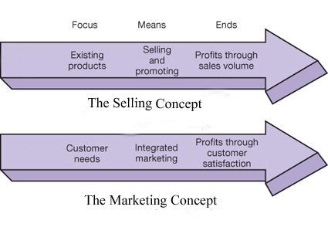
Comparison between Selling and Marketing Concept

Slide 10
Difference between Traditional and Modern Concept
Traditional Concept | Modern Concept
Focus is on product only Objective is profit maximisation Short-term oriented Less promotional activities Narrow concept | Focus is on customers’ needs and wants Objective is customer satisfaction and customer delight Long term oriented Sustained promotional activities Broader concept

Slide 11
Marketing = ?
Marketing is the sum of all activities that take you to a sales outlet. After that sales takes over.
Marketing is all about creating a pull, sales is all about push.
Marketing is all about managing the four P’s –
  product
  price
  place
  promotion

Slide 12
Simple Marketing System
Communication
Industry
(a collection
of sellers)
Goods/services
Market
(a collection
of Buyers)
Money
Information

Slide 13

The 4 Ps & 4Cs
Marketing
Mix
Convenience
Place
Product
Price
Promotion
Customer
Solution
Customer
Cost
Communication

Slide 14
Difference Between - Sales & Marketing ?
Sales
trying to get the customer to want what the company produces
Marketing trying to get the company produce what the customer wants

Slide 15
Scope – What do we market
Goods
Services
Events
Experiences
Personalities
Place
Organizations
Properties
Information
Ideas and concepts

Slide 16
Core Concepts of Marketing
Based on :
Needs, Wants, Desires / demand
Products, Utility, Value & Satisfaction
Exchange, Transactions & Relationships
Markets, Marketing & Marketers.

Slide 17
Core Concepts of Marketing
Needs, wants
demands
Utility, Value &
Satisfaction
Products
Marketing &
Marketers
Xchange, Transaction
Relationships
Markets

Slide 18
Core Concepts of Marketing
Need – food ( is a must )
Want – Pizza, Burger, French fry's ( translation of a need as per our experience )
Demand – Burger ( translation of a want as per our willingness and ability to buy )
Desire – Have a Burger in a five star hotel

Slide 19
The Marketing Process
Business Mission Statement
Objectives
Situation or SWOT Analysis
Marketing Strategy
Target Market Strategy
Marketing Mix
Product
Place/Distribution
Promotion
Price
Implementation Evaluation, Control

Slide 20
P r o d u c t

Slide 21
Product is . . . . .
Anything that is offered to the market for attention, acquisition, use or consumption that satisfies a want or a need

Slide 22
The Marketing Mix
The conventional view of the marketing mix consisted of four components (4 Ps): Product, Price, Place/ distribution and Promotion.
Generally acknowledged that this is too narrow today; now includes , Processes, Productivity [technology ]People [employees], Physical evidence
Marketers today are focused on virtually all aspects of the firm’s operations that have the potential to affect the relationship with customers.

